Slide 1
Real-Time Quality Index Estimation for Redundant Sampled Values Streams in Digital Substations Thesis midterm presentation
Student: Everton Matheus Oriente
Supervisor(s): António Barros
May 2024

Slide 2
Outline
Motivation and Challenges
Hypothesis and Proposed Solution
Current Status
Critical Analysis

Slide 3
Motivation and Challenges
Motivation:
Improve better service to the electrical grid
Improve better quality of energy to the customers
Improve reliability to the grid
Challenge:
Implementation of algorithms in a platform with constrained resources, choosing the best source of VT’s and CT’s while guaranteeing timely execution to the protection alghoritms.

Slide 4
Hypothesis and Proposed Solution
Hypothesis
Development of an algorithm to enhance the selection of the optimal stream sample for evaluating the grid from a different Merging Unit.
Proposed Solution
Evaluate these two different streams based on the average between the two signals.

Slide 5
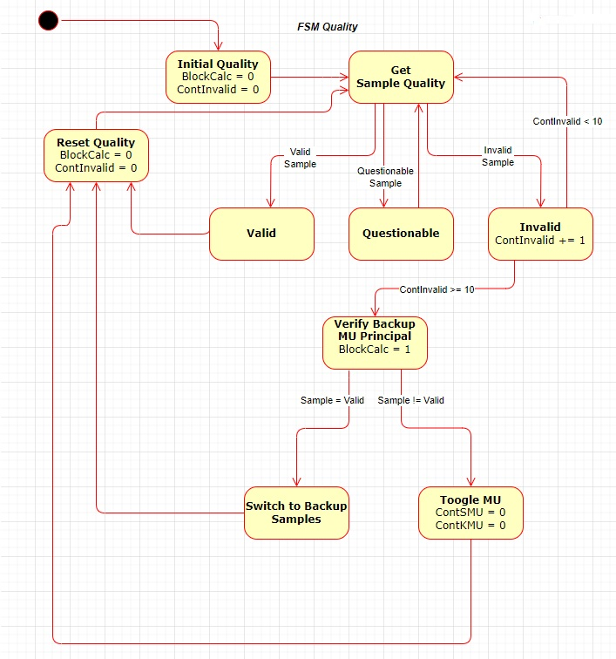
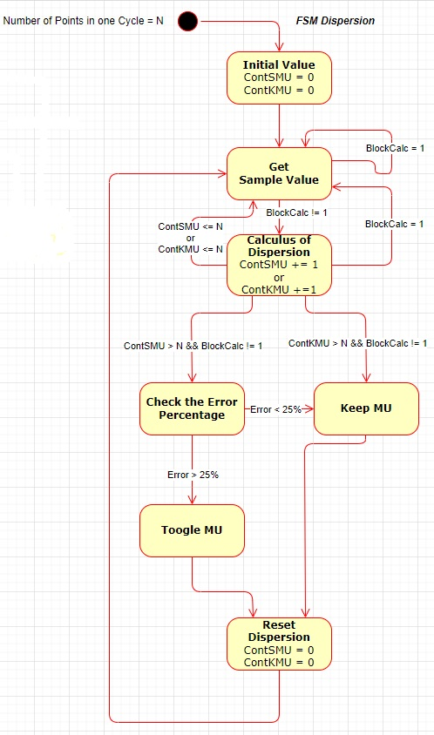
Hypothesis and Proposed Solution

Slide 6
Hypothesis and Proposed Solution
Proposed Solution
X = MU Backup.Value – MU Principal.Value
MU Principal.Value
Y = MU Principal.Value - MU Backup.Value
MU Backup.Value
Erro X = |X|
Erro Y = |Y|

Slide 7
Hypothesis and Proposed Solution
Proposed Solution
If Erro X <= Erro Y
Keep the signal of Merging Unit is send the information.
Else
Change the signal of Merging Unit is send the information.

Slide 8
Current Status
The Full research with IA Alghoritm that can be implemented to solve this issue, using the Dynamic Time Warping (DTW).
There is ongoing validation by my supervisor for the two state machines regarding their implementation.
The implementation of state machine in C, but I also started in Rust.

Slide 9
Critical Analysis
The thesis is going to be developed, but it is suffering some delays regarding the research and choosing the alghoritm it is supposed to choose the correct stream of SV´s packets from IEC61850-9-2. But for now, we develop a plan and this plan is going to be done.

Slide 10
Master in Critical Computing Systems Engineering
http://www.isep.ipp.pt/mescc
mescc@isep.ipp.pt

